Slide 1

Kaggle : GiveMeSomeCredit Data Analysis
Sandheep Gopinath

Slide 2
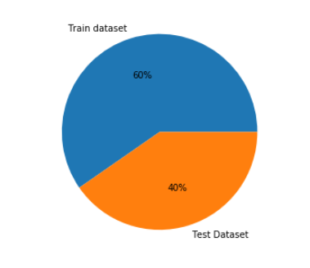
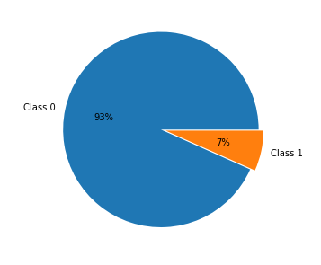
The Dataset
60% Training data and 40% Testing data
Baseline Accuracy : 93%

Slide 3

Biased Dataset
Since the dataset is biased towards one class there is a high chance that the model will predict more of the outputs as Class 1. The models will also show accuracy around 93% with least training.

Slide 4
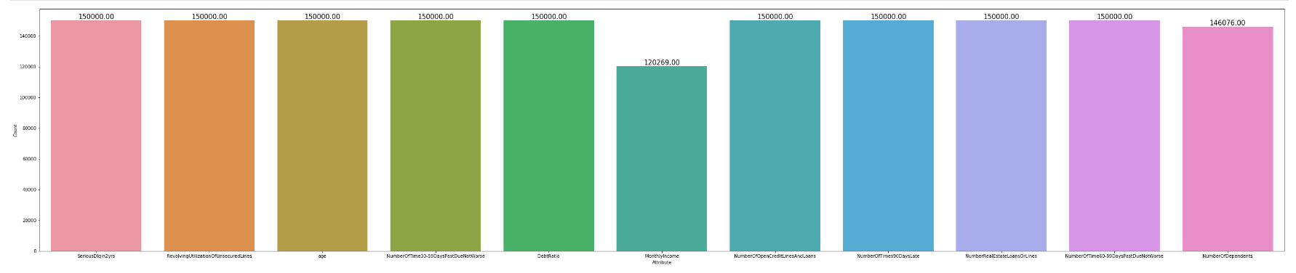
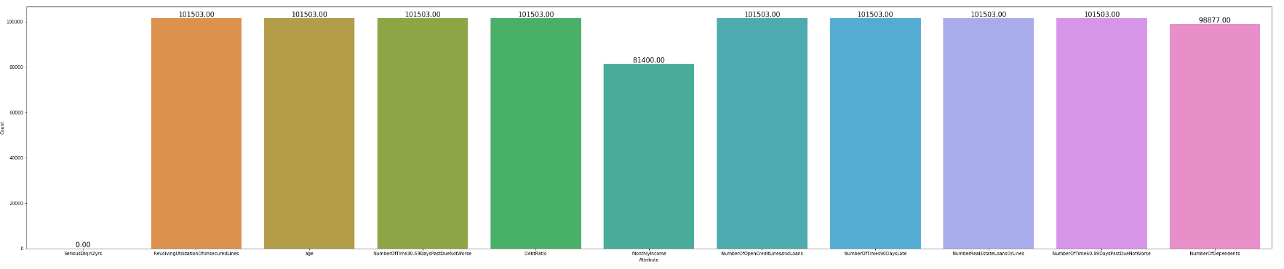
Missing Values
Train Data Info
Test Data Info
Test Data Info

Slide 5
Missing values
The dataset has missing values in Number Of dependents and Income in both training and test dataset.

Slide 6
Handling Missing Values
Kmeans Clustering
Mean and Mode to replace

Slide 7
Handling Missing Values
Random Forest Classifier (60.8% accuracy)
for predicting the
NumberOfDependents
Random Forest Regressor (84% accuracy)
for predicting the
MonthlyIncome

Slide 8
Data Normalisation
Using StandardScaler to bring all attributes to a common range.

Slide 9
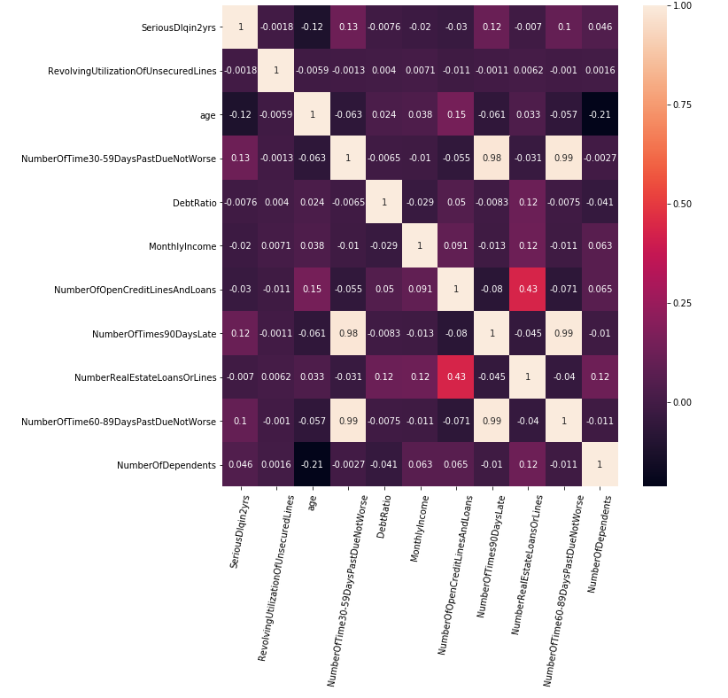
Correlation
Two attributes which had high correlation more than 0.90 were dropped
NumberOfTime60-89DaysPastDueNotWorse
and
NumberOfTimes90DaysLate

Slide 10
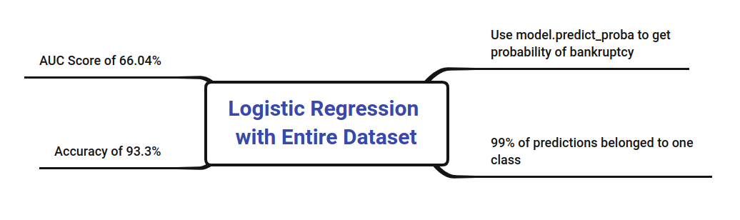
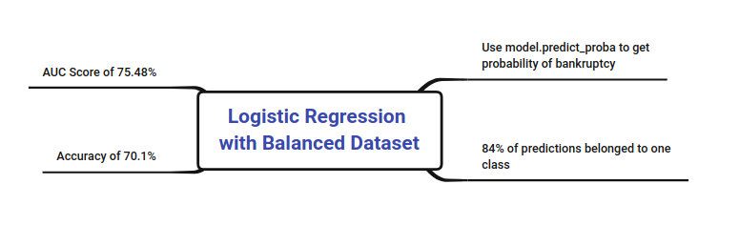
Model Building with Logistic Regression

Slide 11
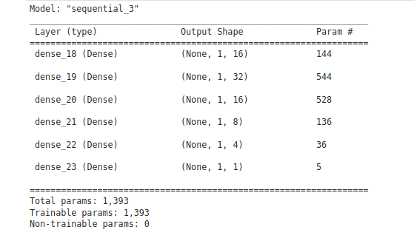
Model Building with Neural Networks
The data has to be converted to np array and the dimension had to be changed by using np.expand_dims so as to fit the model

Slide 12
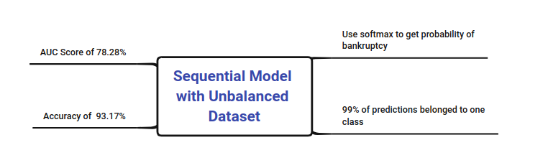
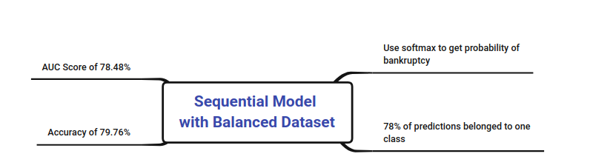
Model Building with Neural Networks

Slide 13

Summary
For the unbalanced dataset, the Accuracy score was higher but the AUC score was low
The high accuracy in unbalanced dataset was because of the model doing predictions in the same class always and that class consisted of 93% of the total data
For the balanced dataset, where we had to drop a large number of data points, the Accuracy was low. However, the AUC had increased
The neural network models were slightly better than Logistic regression.
Kaggle Score : 77.286%

